Slide 1


FED TAPERING
MONEY SUPPLY EXPANSION AND RUN ON A BANK

Slide 2

Understanding ‘Money Supply Expansion” and “Run on a Bank” (New Version) – By Prof. Simply Simple TM

Slide 3

MONEY SUPPLY EXPANSION AND RUN ON A BANK
Sometime back, I had covered a lesson on the working of the ‘Money Supply’.
In this lesson we’ll try to explore another angle of the same concept as well as understand the concept, “Run on a Bank”.

Slide 4

MONEY SUPPLY EXPANSION AND RUN ON A BANK
In the earlier lesson, we saw that an increase in money supply should be done with an objective to benefit the economy as a whole.

Slide 5

MONEY SUPPLY EXPANSION AND RUN ON A BANK
But printing notes is not the best method to increase the supply of money in the economy as it fuels inflation.
However banks also have the power to ‘create’ money by their lending activities.

Slide 6
MONEY SUPPLY EXPANSION AND RUN ON A BANK
As always, let’s take an example to understand this better…
Say there is a farmer called Mr. Manure…

Slide 7
MONEY SUPPLY EXPANSION AND RUN ON A BANK
Suppose he deposits `100 in his savings bank account. His savings bank account will reflect the `100 as deposit.
Although Mr. Manure does not physically have the money with him after depositing `100 in the bank, it still constitutes a part of the money supply because he still has the right to withdraw and spend it.

Slide 8
MONEY SUPPLY EXPANSION AND RUN ON A BANK
Now, what is his bank going to do with the money he has deposited?
It is surely NOT going to keep the `100 with itself till the time
Mr. Manure came back to claim it.
If it were to do that then his money, instead of earning interest in the bank, would actually depreciate.

Slide 9
MONEY SUPPLY EXPANSION AND RUN ON A BANK
Now suppose the bank maintains a reserve of 10%, then it will keep `10 with itself and lend `90 to someone else who is in need.
The borrower, Mr. Spender can either take the loan of `90 and utilize it for value creation like funding his working capital or use it to invest in some asset.

Slide 10
MONEY SUPPLY EXPANSION AND RUN ON A BANK
Remember that all this while the lending of `90 by the bank, in no way, would lead to a reduction of `90 from Mr. Manure’s deposit as technically Mr. Manure can withdraw this amount if he needs it.

Slide 11
MONEY SUPPLY EXPANSION AND RUN ON A BANK
Now let’s say Mr. Spender makes a payment out of the borrowed money for buying an asset. The seller (Mr. Selar) of the asset in turn would deposit the `90 in his bank which would hold back 10% (` 9) in the bank and lend the balance `81 to another borrower and so on and so forth the cycle repeats itself as shown in the next slide.

Slide 12
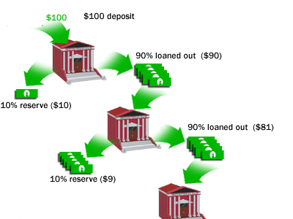

MONEY SUPPLY EXPANSION AND RUN ON A BANK
So this is how money grows & its supply increases…

Slide 13
MONEY SUPPLY EXPANSION AND RUN ON A BANK
All our banks keep part of the deposits as reserves for meeting the day-to-day redemption of other depositors and lend the remainder to their borrowers.
The assumption being, “Not all depositors would demand their money at the same time”.

Slide 14
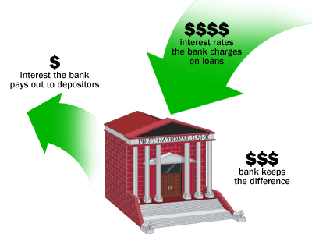
MONEY SUPPLY EXPANSION AND RUN ON A BANK
Thus by expanding money supply as explained the bank is able to earn an interest and pass on a portion of the same to the depositor as interest income.

Slide 15
MONEY SUPPLY EXPANSION AND RUN ON A BANK
Let’s get a better understanding of how bank’s meet the redemption demand even as they lend most of the deposited money.
It does this through the help of the 10% reserves that it holds from all depositors.
The aggregation of the 10% that it holds becomes a large enough reserve to fund some of the expected redemptions.

Slide 16
MONEY SUPPLY EXPANSION AND RUN ON A BANK
Remember not all depositors break their deposits.
This is the key principle that keeps the money supply engine chugging along.
Hence this 10% Cash Reserve Ratio (or CRR as it is popularly known) is good enough to handle redemptions.
Therefore the 90% that is given as loans to borrowers constitutes additional money supply for the economy.

Slide 17
MONEY SUPPLY EXPANSION AND RUN ON A BANK
Thus the `100 which was deposited with the bank created ` 190 for the economy at the first step and ` 271 (100 + 90 + 81) at the second step and so on and so forth.
At a macro level, this causes the expansion of money supply.

Slide 18
MONEY SUPPLY EXPANSION AND RUN ON A BANK
But in case there is negative news about overall economy like what we witnessed in the 2008 economic meltdown, it may happen that a disproportionately large number of depositors approach the bank all at once to withdraw their deposits.
At such times the bank can get into a fix by not having the requisite money for meeting the depositor’s demands. This is when we say, ”there is a run on the bank”.

Slide 19
MONEY SUPPLY EXPANSION AND RUN ON A BANK
A bank run (also known as a run on the bank) occurs when a large number of bank customers withdraw their deposits because they believe the bank is, or might become, insolvent.
As a bank run progresses, it generates its own momentum: as more people withdraw their deposits, the likelihood of default increases, and this encourages further withdrawals.
This can destabilize the bank to the point where it faces bankruptcy!

Slide 20
MONEY SUPPLY EXPANSION AND RUN ON A BANK
When a run comes, Mr. Manure’s bank must quickly increase its cash to meet depositors’ demands.
It does so primarily by selling assets, often hastily and at fire-sale prices.
As it holds little capital and is highly leveraged, losses on these sales can further hurt the health of the bank’s books of accounts.

Slide 21
MONEY SUPPLY EXPANSION AND RUN ON A BANK
The run on a bank has been captured very interestingly in pictorial form in the next slide.

Slide 22


Slide 23
MONEY SUPPLY EXPANSION AND RUN ON A BANK
Hope this lesson has succeeded in further clarifying the concept of “Expansion of money supply” well as
“Run on a bank”.

Slide 24

Please give me your feedback at
professor@tataamc.com

Slide 25

DISCLAIMER
The views expressed in this lesson are for information purposes only and do not construe to be any investment, legal or taxation advice. The lesson is a conceptual representation and may not include several nuances that are associated and vital. The purpose of this lesson is to clarify the basics of the concept so that readers at large can relate and thereby take more interest in the product / concept. In a nutshell, Professor Simply Simple lessons should be seen from the perspective of it being a primer on financial concepts. The contents are topical in nature and held true at the time of creation of the lesson. This is not indicative of future market trends, nor is Tata Asset Management Ltd. attempting to predict the same. Reprinting any part of this material will be at your own risk. Tata Asset Management Ltd. will not be liable for the consequences of such action.
Mutual Fund investments are subject to market risks, read all scheme related documents carefully.

